Slide 1

Android Studio
#13
Android Studio
“ Online Cloud Database,
Common app solutions: Firebase ”

Slide 2
INNEHÅLLSFÖRTECKNING
01
03
02
04
Översikt
Firebase Persist & Read
Firebase Setup
Compose SideEffect

Slide 3
INNEHÅLLSFÖRTECKNING
05
Övningar & Uppgifter

Slide 4
01
ÖVERSIKT

Slide 5

Firebase the NOSQL cloud realtime DB

Slide 6

Firebase
Används inte ROOM?
Online / Cloud (Offline to disk works too)
NoSQL
Realtime Database
Cannot export from Firebase (you’re stuck with firebase if you use it)
Easy and well documented process
Quick setup

Slide 7


Frågor?

Slide 8
02
Firebase Setup

Slide 9
Firebase
RESTRICTIONS

Slide 10
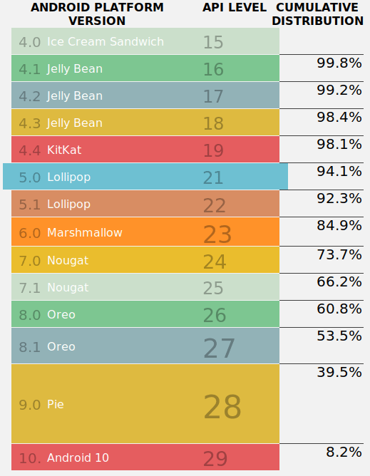

FireBase
API LEVEL
KitKat API level 19

Slide 11

FireBase Criteria
Övriga kriterier:
- Uses Android 4.4 or higher
- Använder sig av Jetpack, som inkluderar följande kriterier:
- com.android.tools.build:gradle v3.2.1 eller senare
- compileSdkVersion 28 eller senare
Glöm inte att logga in med ditt Google konto

Slide 12
Firebase
Limitations

Slide 13
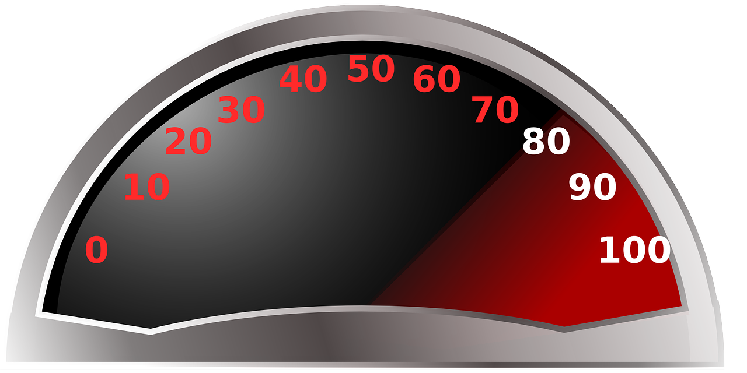
FireBase Limitations
https://firebase.google.com/docs/database/usage/limits

Slide 14
Firebase: How to

Slide 15
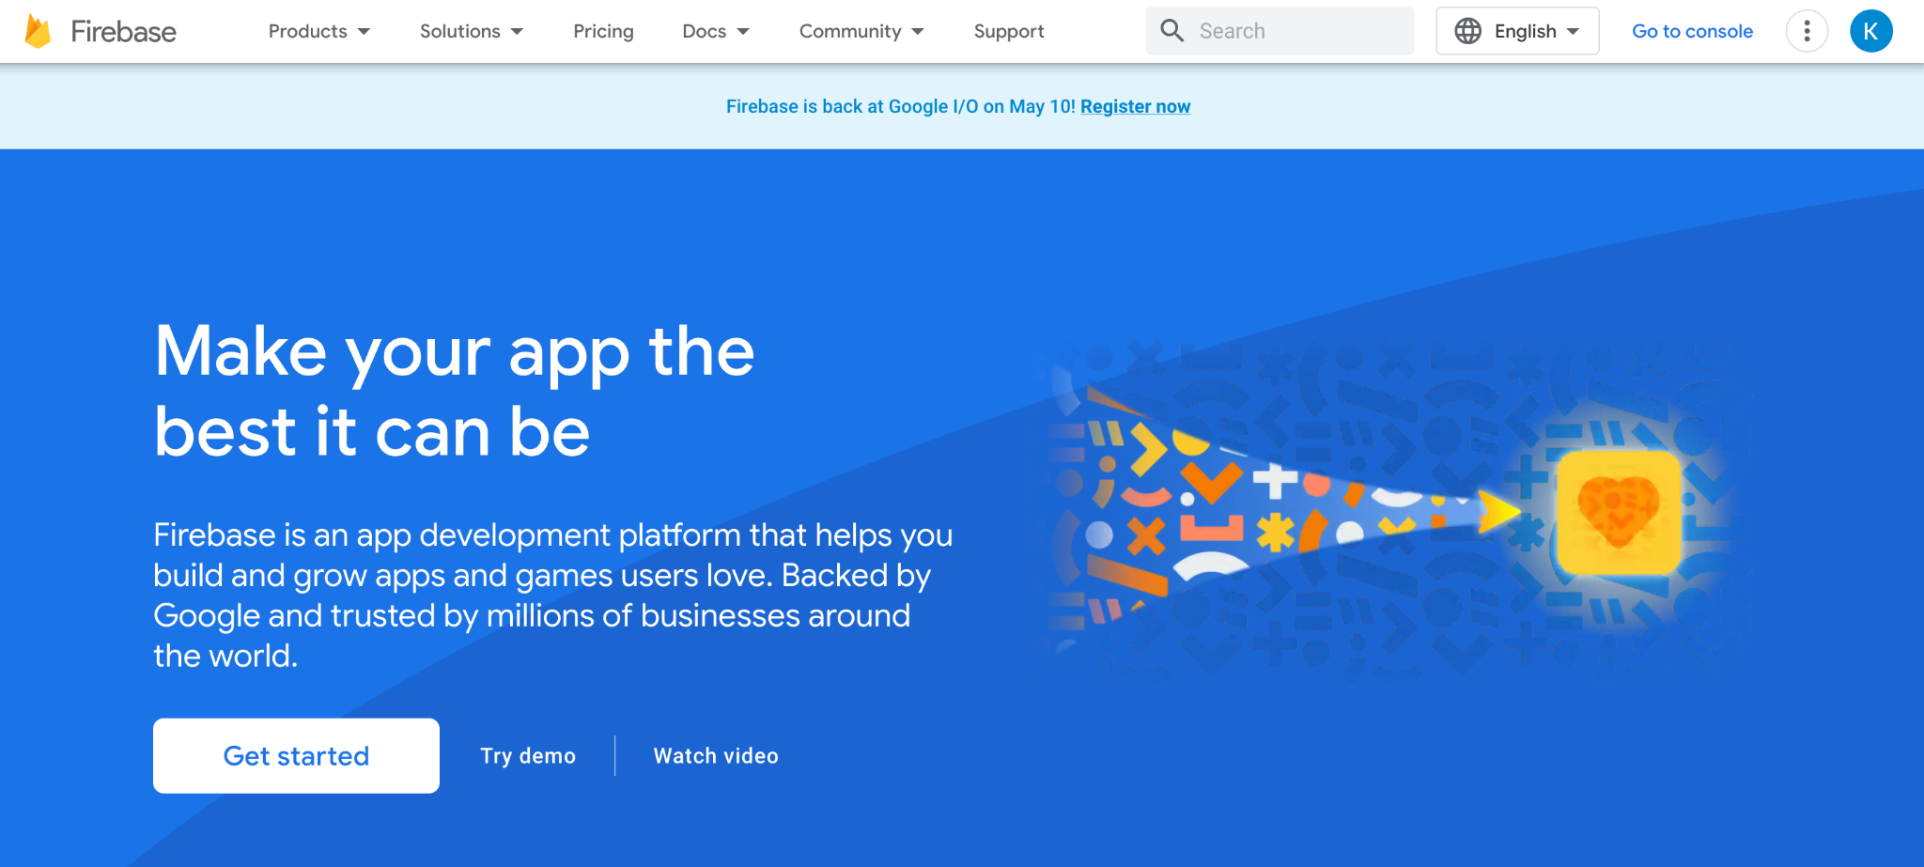
Sign up & get started
Just nu är jag inloggad, du behöver ett konto!

Slide 16
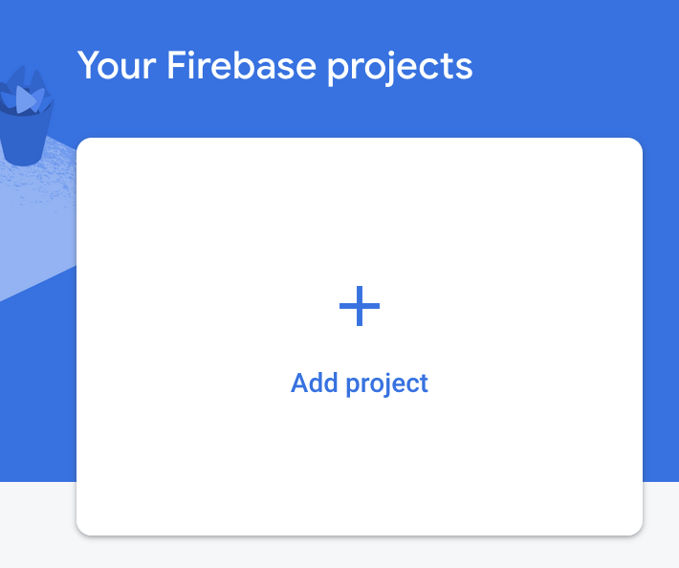
Add Project +
Lägg till!

Slide 17
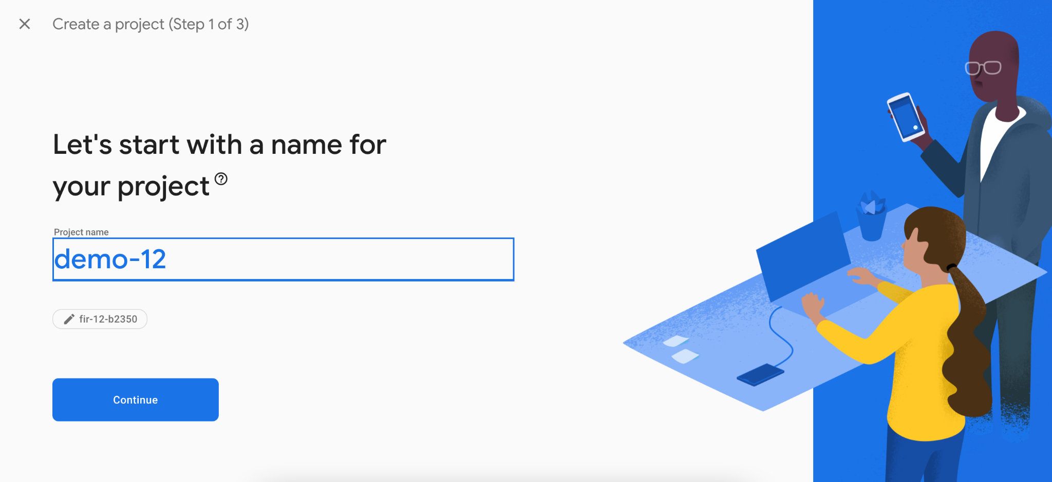
Naming
Lägg till!
Demo-13

Slide 18
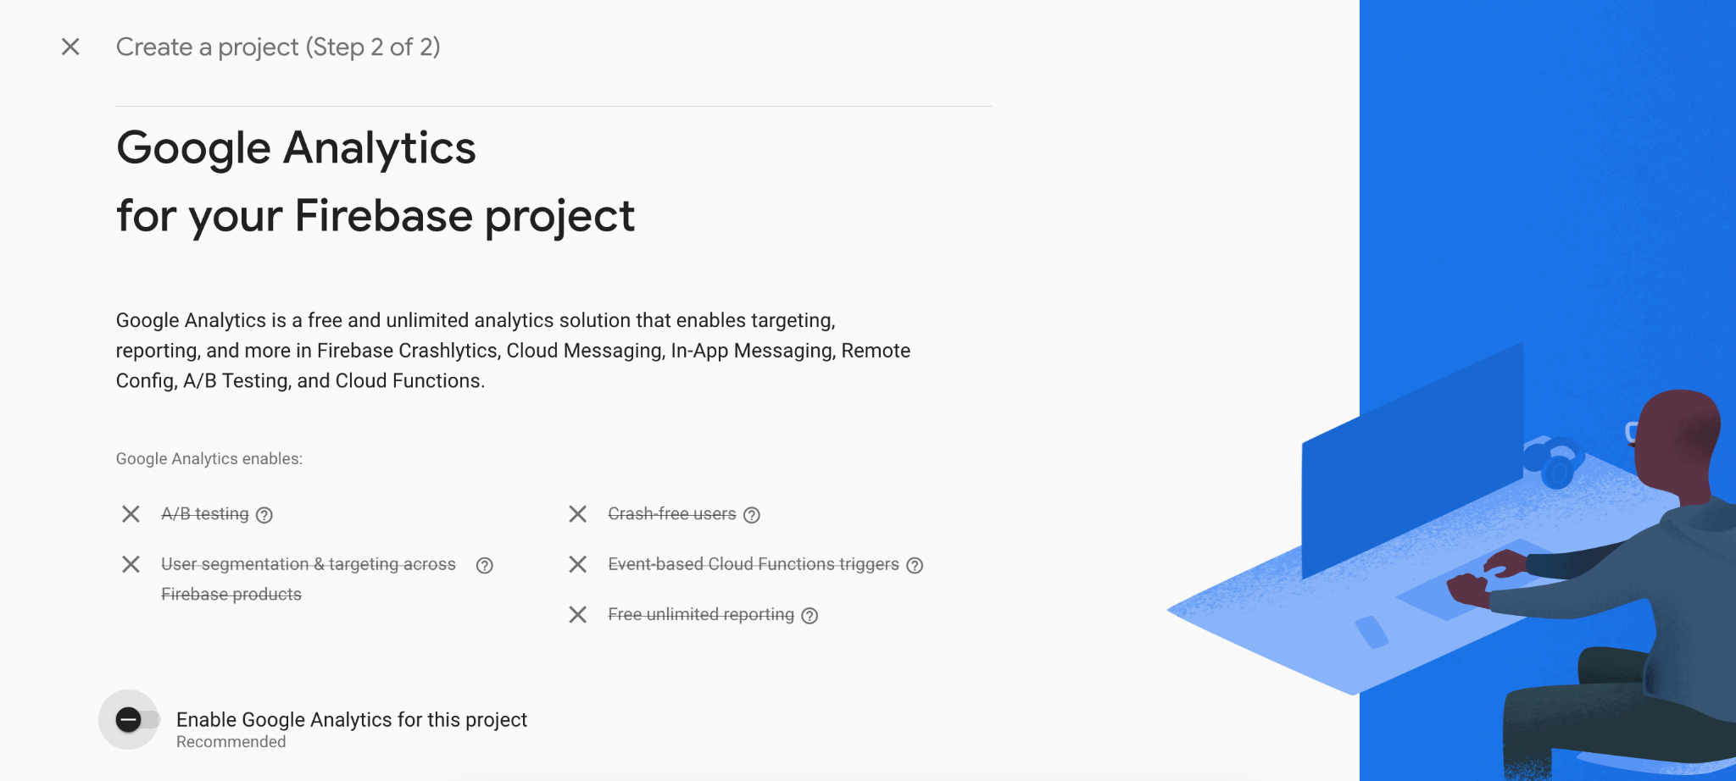
Google Analytics

Slide 19
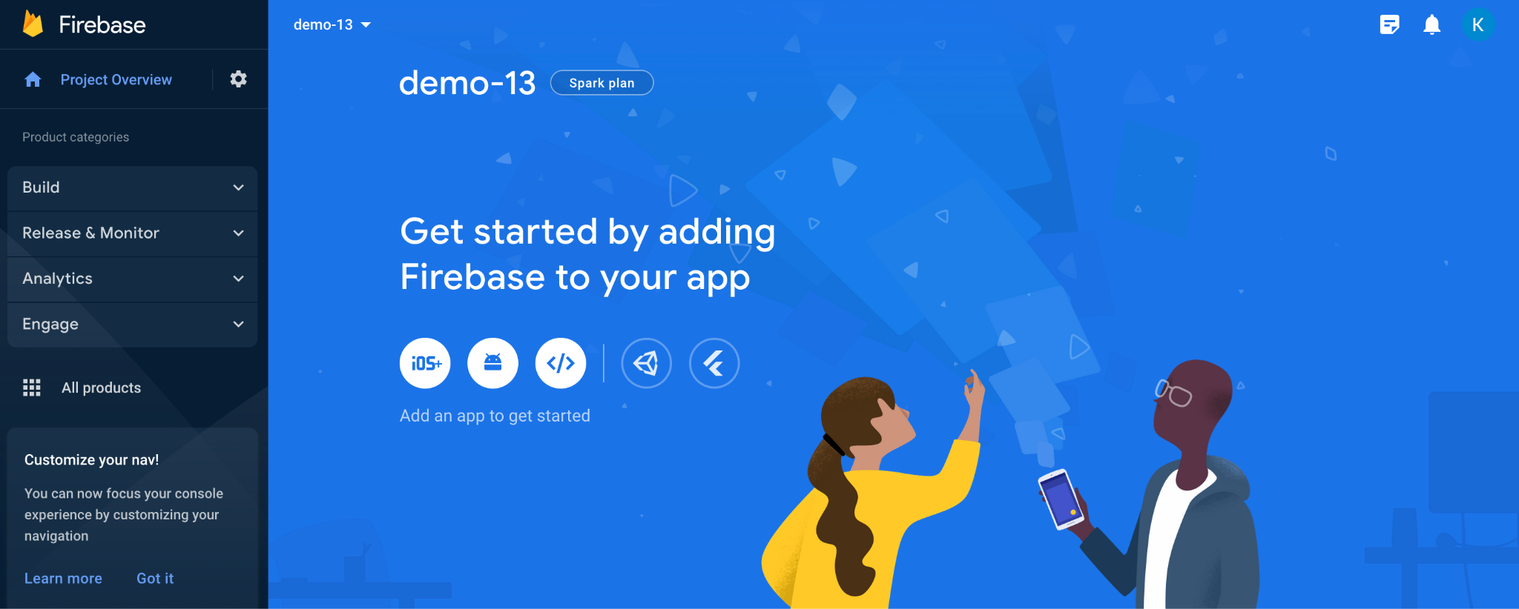
Android

Slide 20
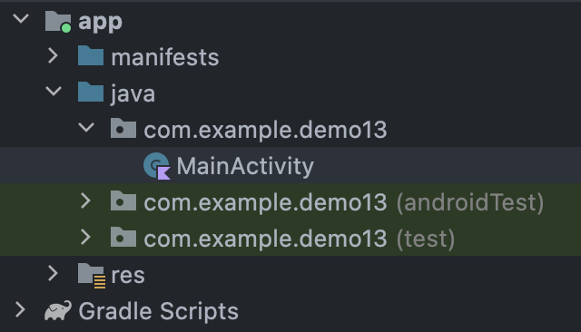
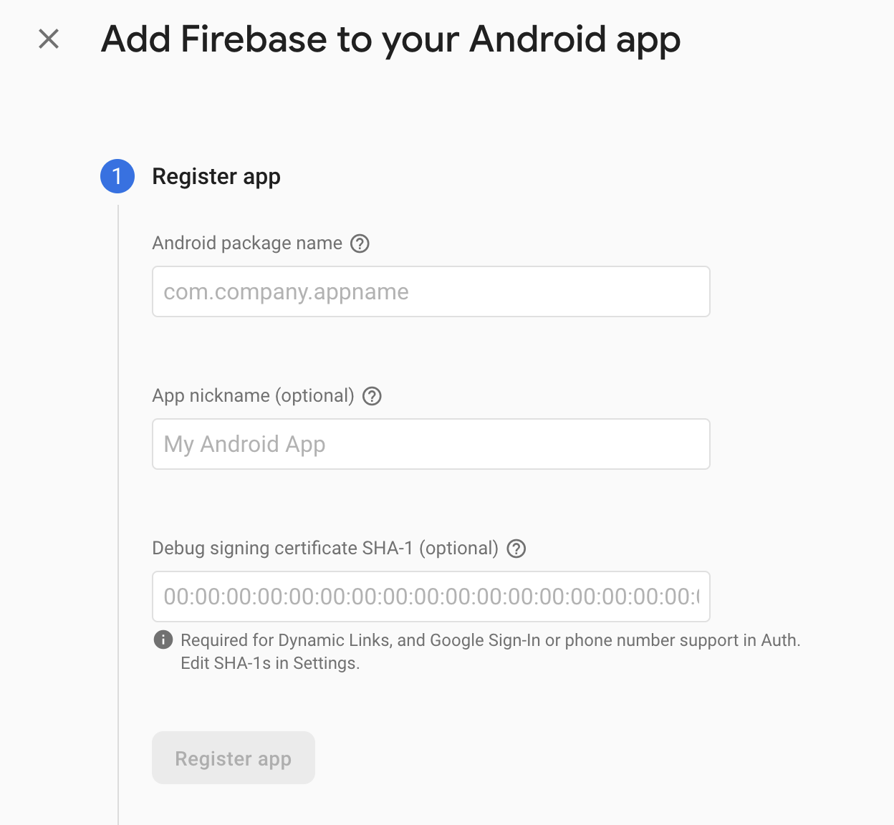
Package
Detta MÅSTE matcha!

Slide 21
Register
← com.example.demo13
← Android Studio Firebase Demo
← BLANK

Slide 22
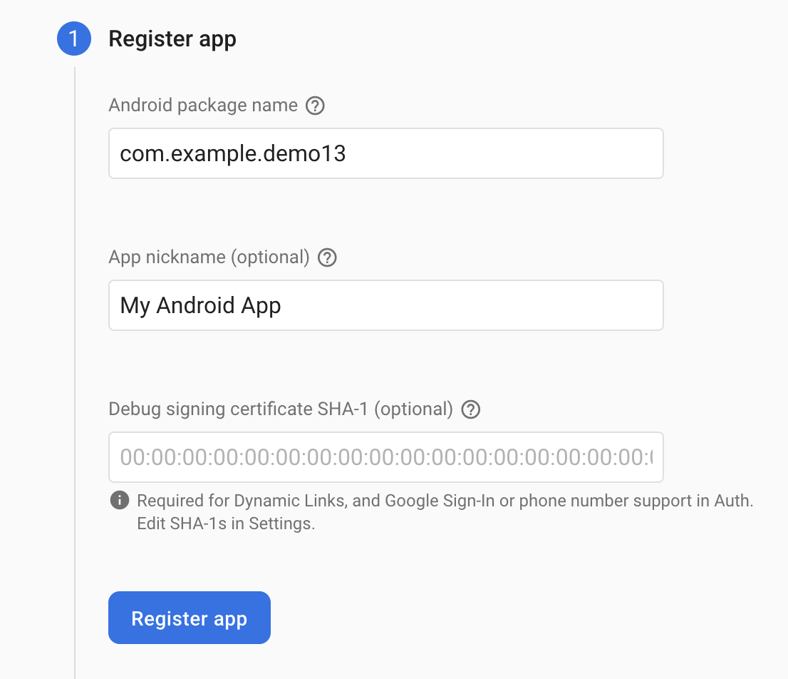
Setup

Slide 23
Setup

Slide 24
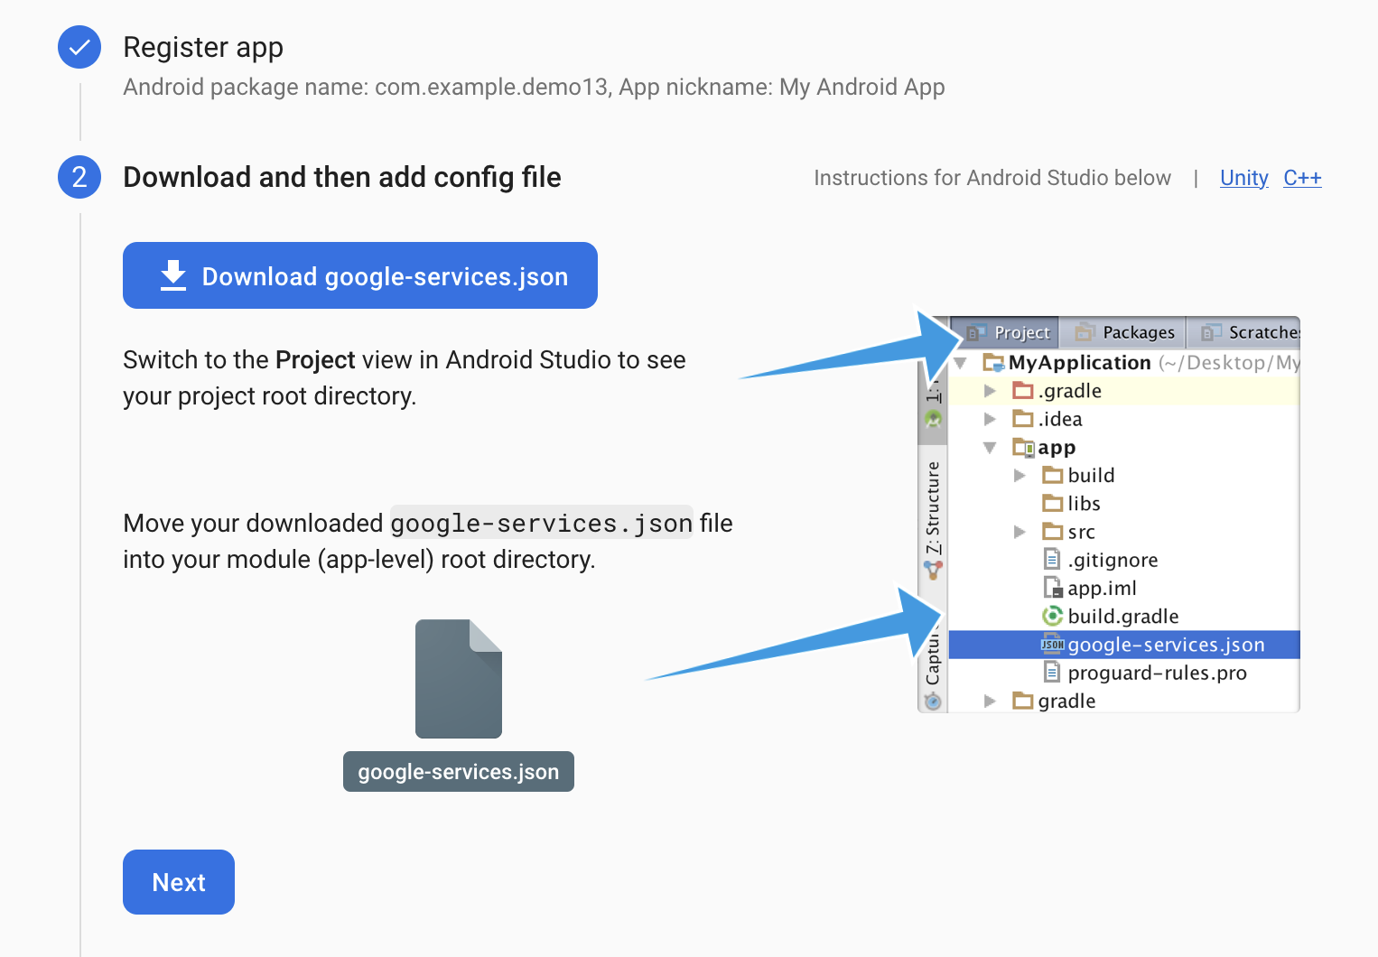
Setup

Slide 25
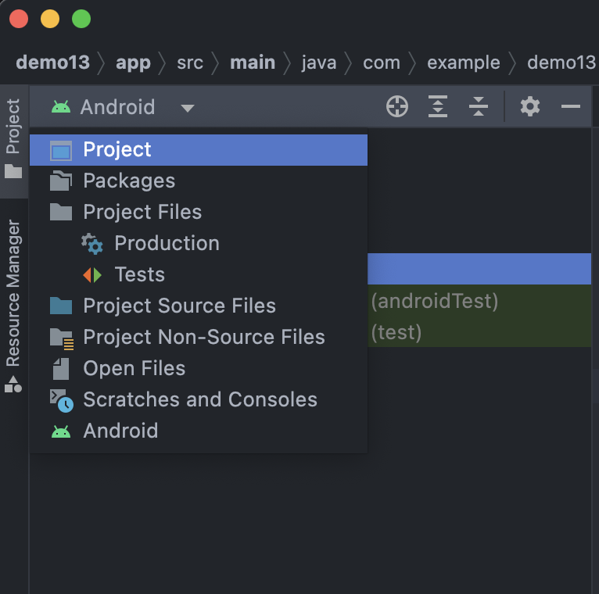
Project View

Slide 26
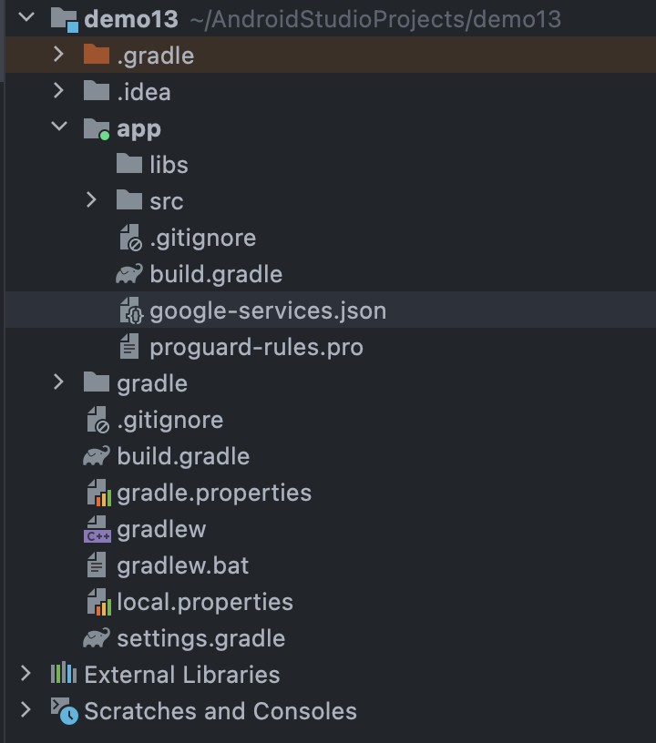
Drag And Drop

Slide 27
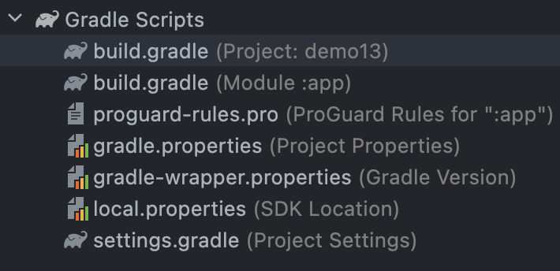
Project Gradle

Slide 28
Dependencies
// Top-level build file where you can add configuration options common to all sub-projects/modules.
buildscript {
repositories {
// Make sure that you have the following two repositories
google() // Google's Maven repository
mavenCentral() // Maven Central repository
}
dependencies {
// Add the dependency for the Google services Gradle plugin
classpath 'com.google.gms:google-services:4.3.15'
}
}
plugins {
id 'com.android.application' version '7.4.2' apply false
id 'com.android.library' version '7.4.2' apply false
id 'org.jetbrains.kotlin.android' version '1.8.0' apply false
}

Slide 29
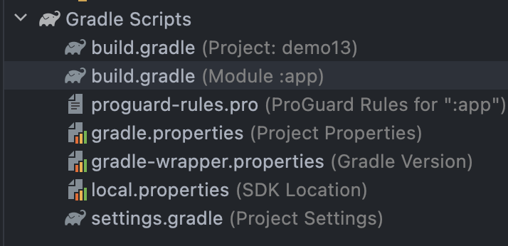
Setup

Slide 30
Plugin
plugins {
id 'com.android.application'
id 'org.jetbrains.kotlin.android'
id 'com.google.gms.google-services'
}

Slide 31
Dependency
Dependency!
// Import the Firebase BoM
implementation platform('com.google.firebase:firebase-bom:31.2.3')
// TODO: Add the dependencies for Firebase products you want to use
// When using the BoM, don't specify versions in Firebase dependencies
// https://firebase.google.com/docs/android/setup#available-libraries

Slide 32
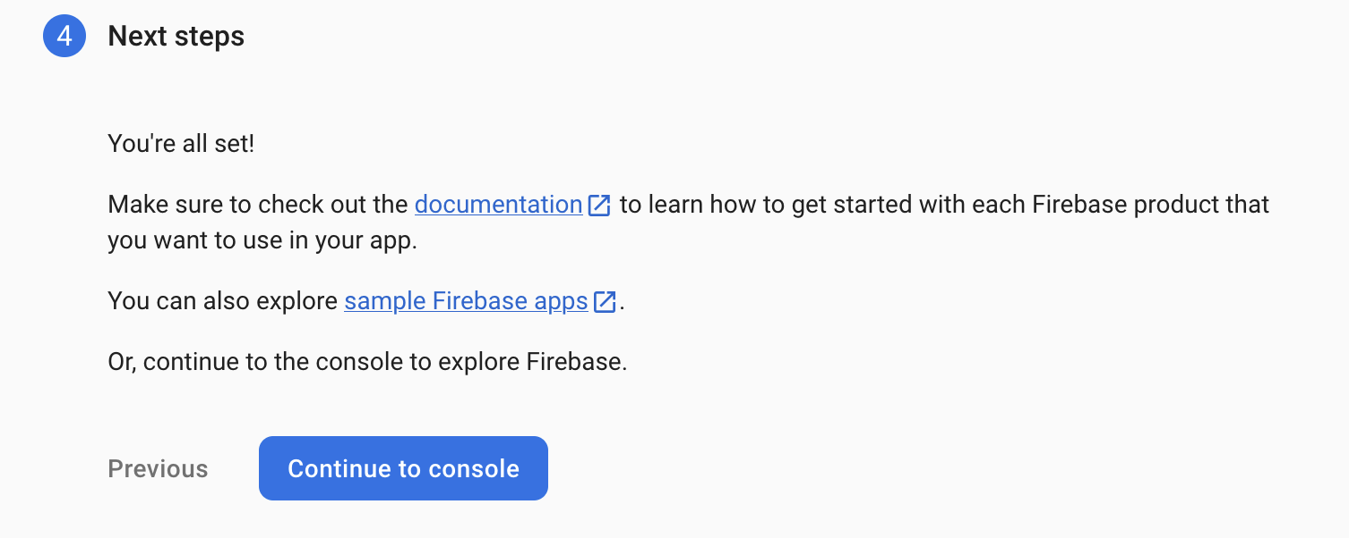
Setup Complete
Documentation https://firebase.google.com/docs/guides?authuser=0&hl=en
Sample apps: https://firebase.google.com/docs/samples?authuser=0&hl=en

Slide 33
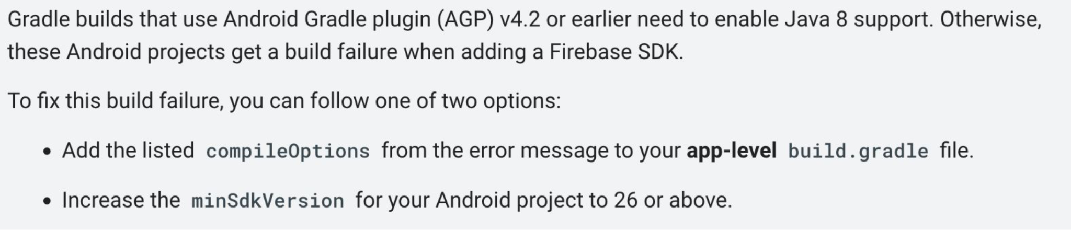
Restriction!

Slide 34
What’s next?
Add Firebase services to your app:
● Gain insights on user behavior with Analytics.
● Set up a user authentication flow with Authentication.
● Store data, like user information, with Cloud Firestore or Realtime Database.
● Store files, like photos and videos, with Cloud Storage.
● Trigger backend code that runs in a secure environment with Cloud Functions.
● Send notifications with Cloud Messaging.
● Find out when and why your app is crashing with Crashlytics.

Slide 35
Realtime Database Setup

Slide 36
Realtime DB
Dependency
Vi kommer sätta upp en ‘Realtime Database’
// Add the dependency for the Realtime Database library
// When using the BoM, you don't specify versions in Firebase library dependencies
implementation("com.google.firebase:firebase-database-ktx")

Slide 37
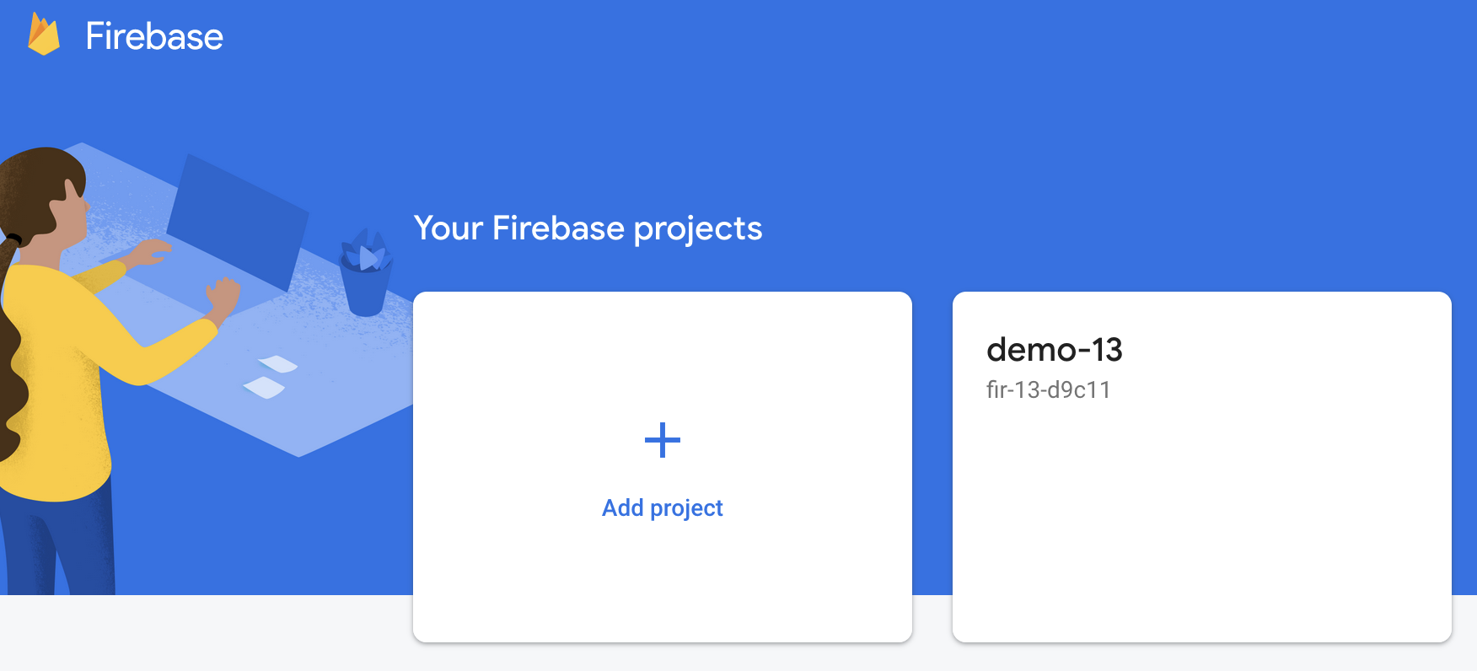
Enter Project
https://console.firebase.google.com/

Slide 38
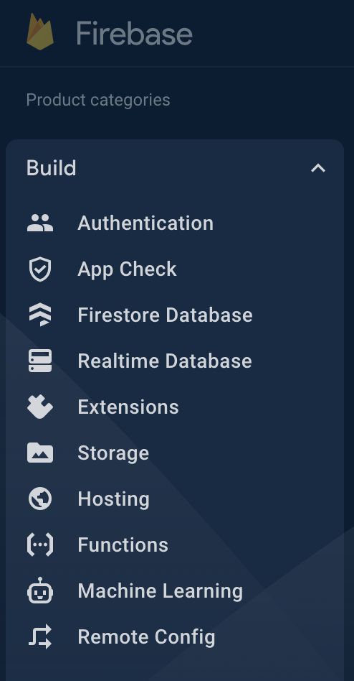
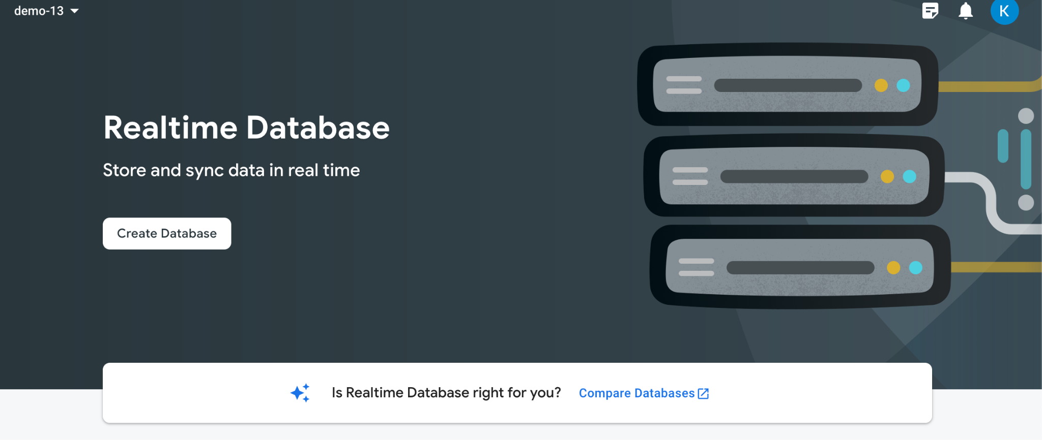
Realtime DB

Slide 39
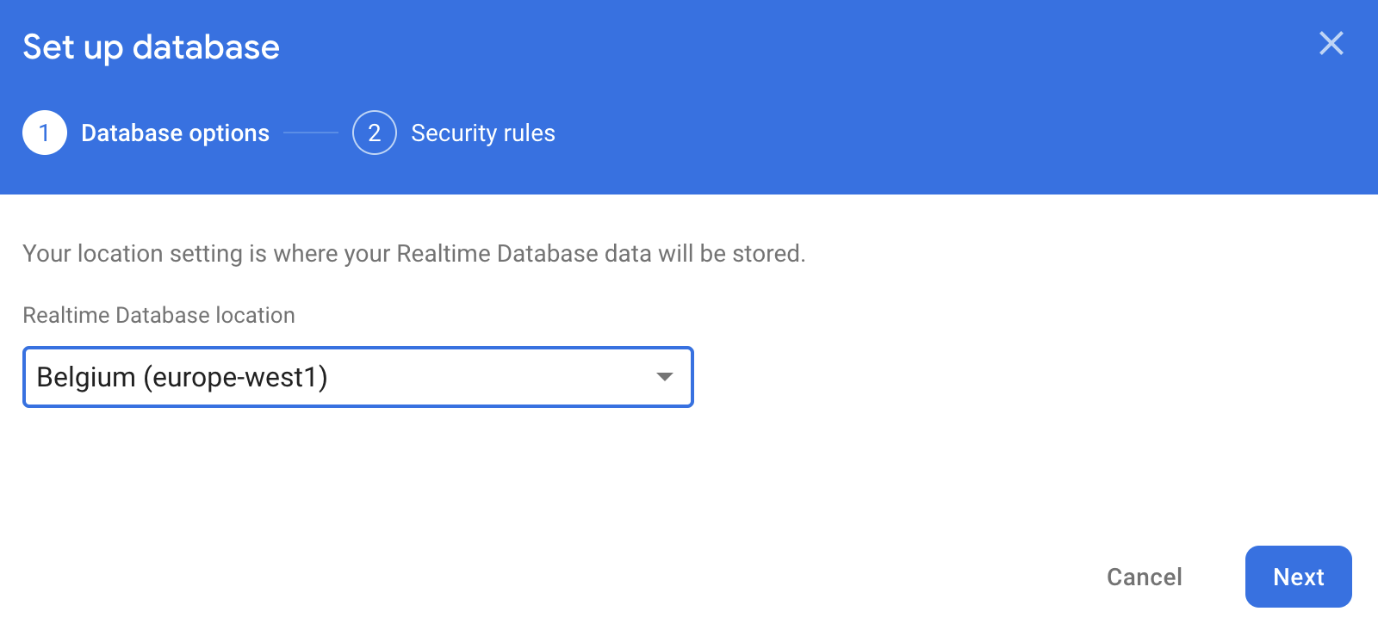
Europe

Slide 40
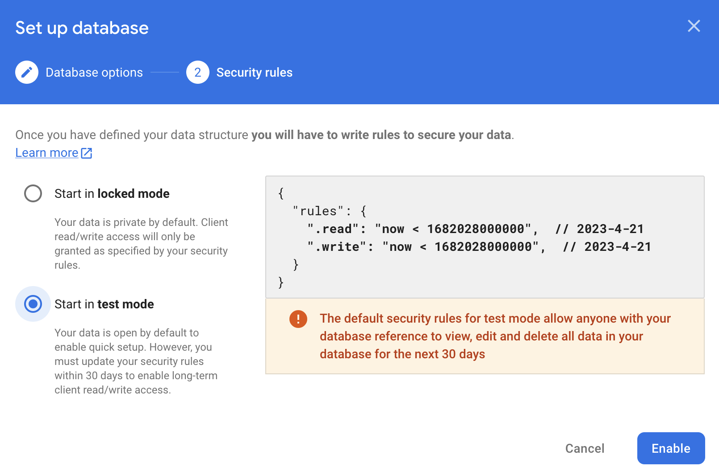
Test Mode

Slide 41
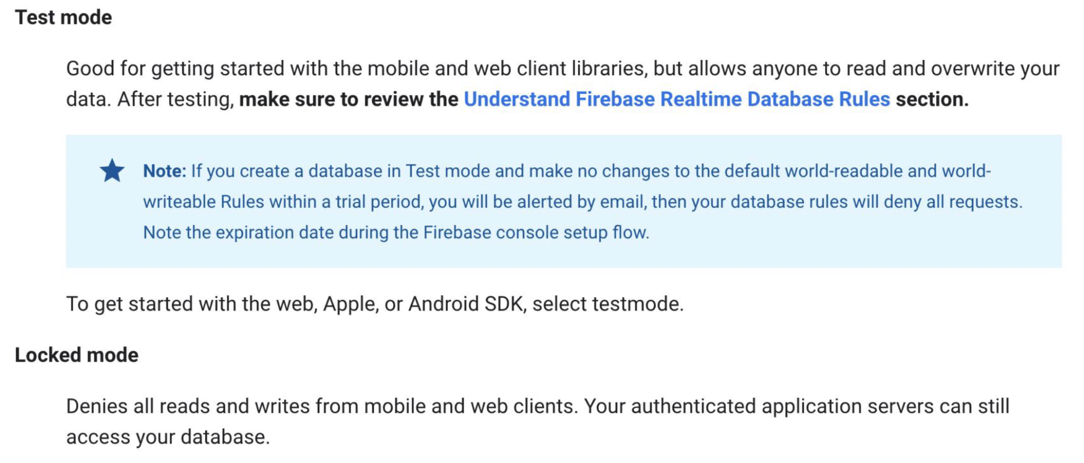
Test Mode

Slide 42
03
Read & Write
to Firebase

Slide 43
Setup

Slide 44
Initialize
package com.example.demo13
import androidx.appcompat.app.AppCompatActivity
import android.os.Bundle
import com.google.firebase.database.DatabaseReference
class MainActivity : AppCompatActivity() {
private lateinit var db : DatabaseReference
override fun onCreate(savedInstanceState: Bundle?) {
super.onCreate(savedInstanceState)
setContentView(R.layout.activity_main)
}
}

Slide 45
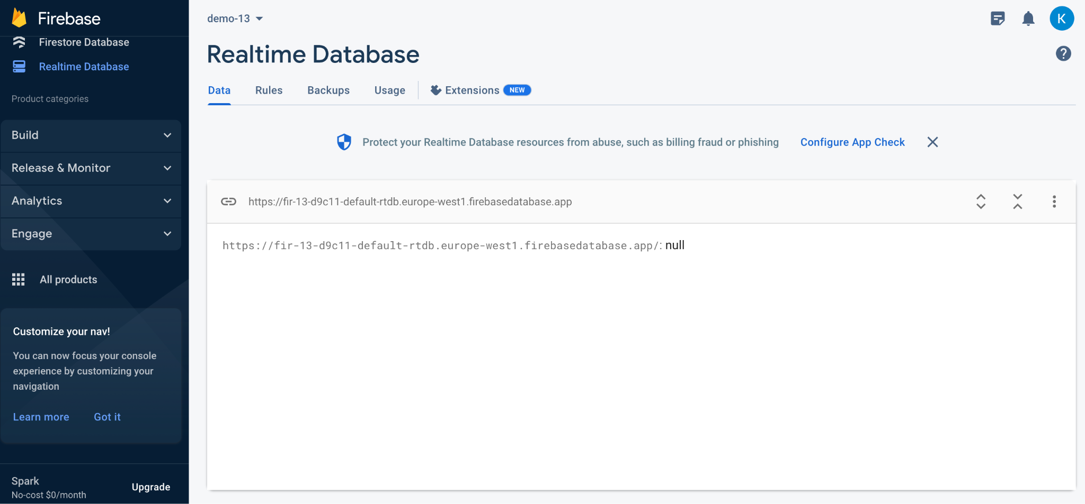
Link
Kopiera länk!

Slide 46
URL
override fun onCreate(savedInstanceState: Bundle?) {
super.onCreate(savedInstanceState)
setContentView(R.layout.activity_main)
db = FirebaseDatabase
.getInstance("YOUR_URL_HERE")
.getReference("users")
}

Slide 47
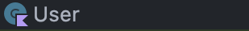
URL
package com.example.demo13
data class User(
val name: String? = null,
val password: String? = null
) {
}

Slide 48
Database Operations

Slide 49
Push USER
db.setValue(
User("Benny", "Bananas")
).addOnSuccessListener {
Toast.makeText(this, "Pushed user", Toast.LENGTH_LONG).show()
}.addOnFailureListener {
Toast.makeText(this, "FAILURE", Toast.LENGTH_LONG).show()
}

Slide 50
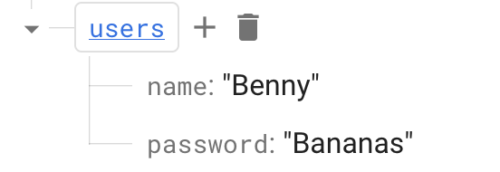
Persisted!

Slide 51
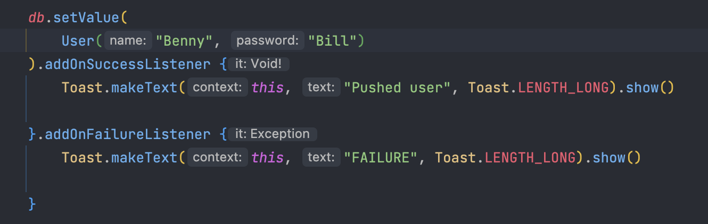
Update User

Slide 52
Add User
(push)
db.push().setValue(
User(
username = "Frida",
password = "123",
isEnabled = false,
isVerified = false
)
)
.addOnSuccessListener { toastSuccess.show() }
.addOnFailureListener { toastFailure.show() }
}

Slide 53
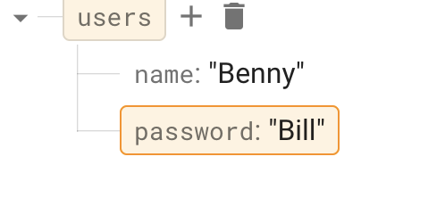
Updated!

Slide 54
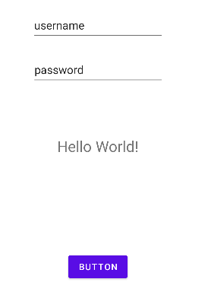
Design
// ID's
val teUsername = findViewById<EditText>(R.id.et_username)
val tePassword = findViewById<EditText>(R.id.et_password)
val tvDb = findViewById<TextView>(R.id.tv_db)
val btnSubmitUser = findViewById<Button>(R.id.btn_submit)

Slide 55
Listen for Changes
Lyssnare för databasändringar
val userListener = object : ValueEventListener {
override fun onDataChange(snapshot: DataSnapshot) {
TODO("Not yet implemented")
}
override fun onCancelled(error: DatabaseError) {
TODO("Not yet implemented")
}
}

Slide 56
Listen For Changes
private fun addUserEventListener(
userReference: DatabaseReference,
textView: TextView) {
val userListener = object : ValueEventListener {
override fun onDataChange(snapshot: DataSnapshot) {
val user = snapshot.getValue<User>()
textView.text = user.toString()
}
override fun onCancelled(error: DatabaseError) {
println(error)
}
}
userReference.addValueEventListener(userListener)
}
Vi passar in databasen + textvyn som vi vill ska visa upp vår NYA förändring

Slide 57
Design
private fun addUser(db: DatabaseReference, context: Context, username: String, password: String) {
db.setValue(
User(username, password)
).addOnSuccessListener {
Toast.makeText(context, "Pushed user $username $password", Toast.LENGTH_LONG).show()
}.addOnFailureListener {
Toast.makeText(context, "FAILURE", Toast.LENGTH_LONG).show()
}
}

Slide 58
OnCreate()
// ID's
val tvDb = findViewById<TextView>(R.id.tv_db)
val teUsername = findViewById<EditText>(R.id.et_username)
val tePassword = findViewById<EditText>(R.id.et_password)
val btnSubmitUser = findViewById<Button>(R.id.btn_submit)
db = FirebaseDatabase
.getInstance("https://fir-13-d9c11-default-rtdb.europe-west1.firebasedatabase.app/")
.getReference("users")
btnSubmitUser.setOnClickListener {
addUser(db, this, teUsername.text.toString(), tePassword.text.toString())
}
addUserEventListener(db, tvDb)

Slide 59
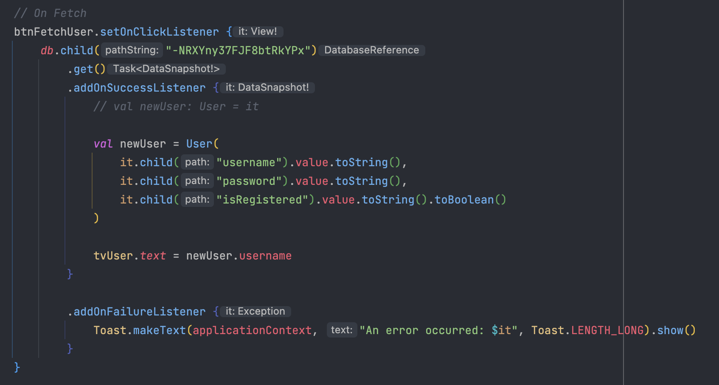
Fetch User

Slide 60
Fetch User
/* Info
* db.orderByChild("users") <-- Fetches ALL users
* db.child("-NRXYny37FJF8btRkYPx") <-- Fetches ID
* */

Slide 61
04
Compose SideEffect

Slide 62
SideEffects?

Slide 63
3 Composables
Parent Composable
Counter: 0
Retrofit Requests
Add + 1

Slide 64
First Step
Parent Composable
Request Runs initially
Counter: 0
Retrofit Requests
Add + 1

Slide 65
3 Composables
Parent Composable
What happens when you click?
Counter: 0
Retrofit Requests
Add + 1

Slide 66
3 Composables
Parent Composable
Counter: 1
Retrofit Requests
+1
AND
Recomposes BOTH
Makes retrofit run another request on each click
Add + 1

Slide 67
Example
LOOP
@Composable
fun ParentScreen() {
val parentCounter = remember { mutableStateOf(0) }
val childCounter = remember { mutableStateOf(0) }
SideEffect {
// Update the parent and child counters
parentCounter.value++
childCounter.value++
}
Column {
Text(text = "Parent counter: ${parentCounter.value}")
ChildScreen(childCounter.value)
}
}

Slide 68
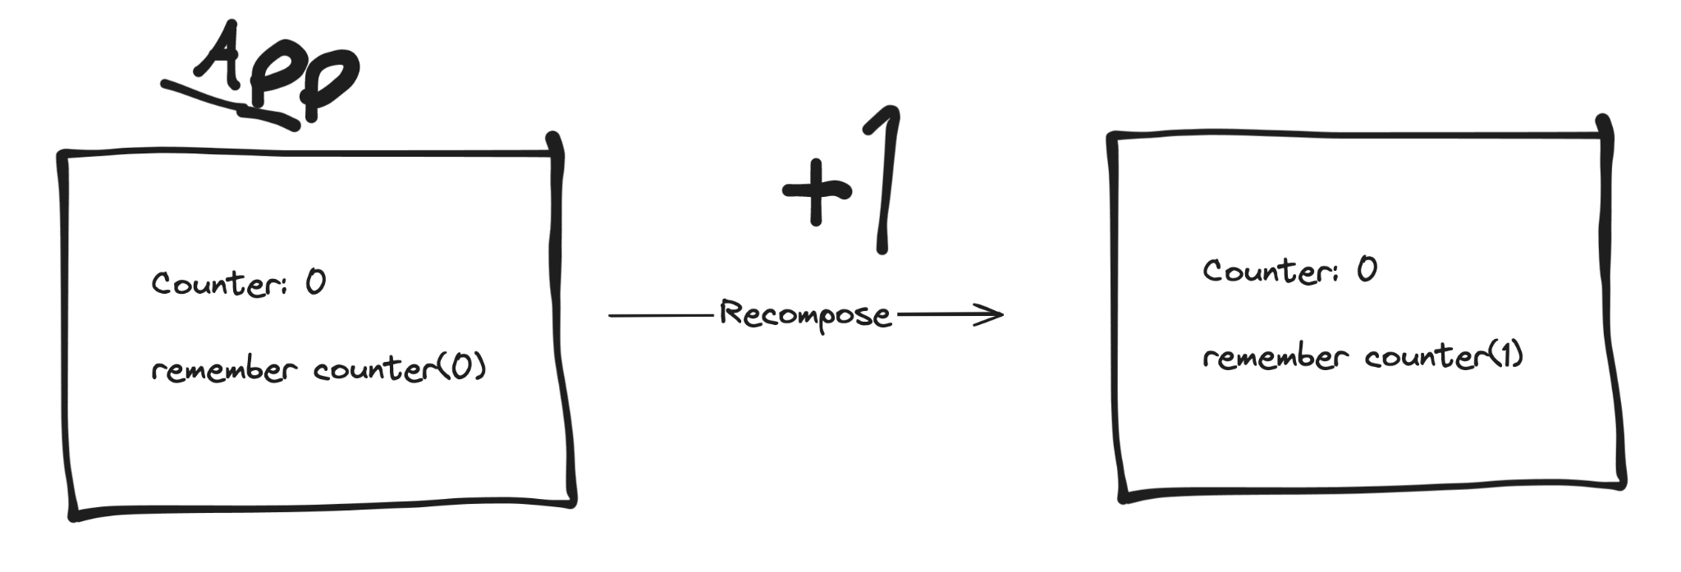
Remember
keyword
@Composable
fun ParentScreen() {
val parentCounter = remember { mutableStateOf(0) }
val childCounter = remember { mutableStateOf(0) }
SideEffect {
// Update the parent and child counters
parentCounter.value++
childCounter.value++
}
Column {
Text(text = "Parent counter: ${parentCounter.value}")
ChildScreen(childCounter.value)
}
}

Slide 69
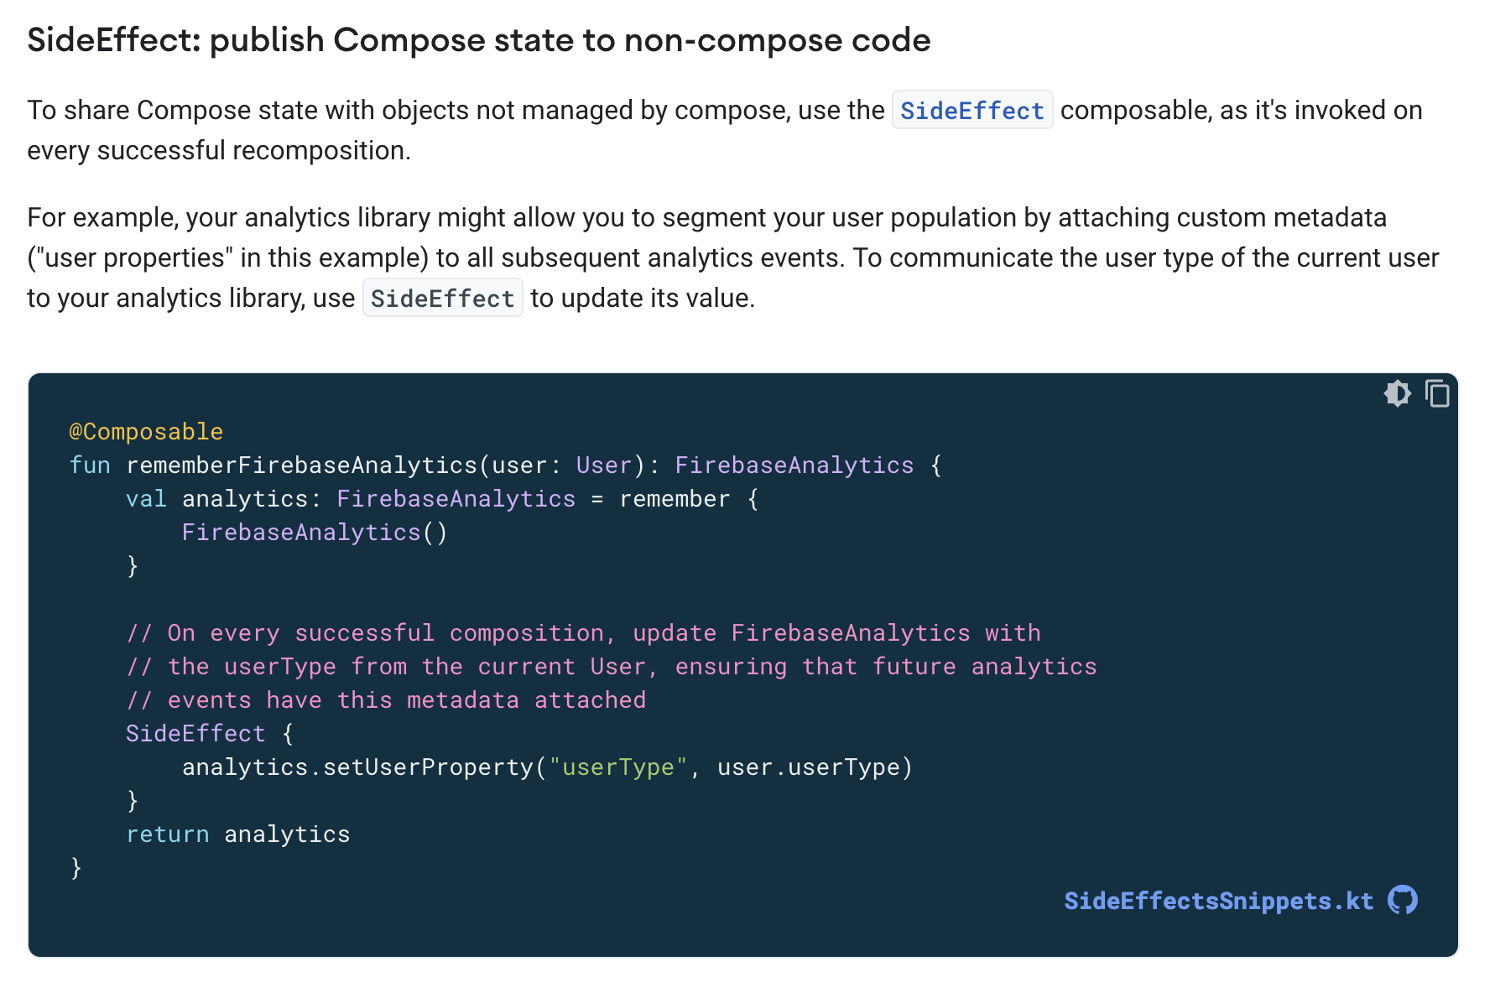
The Solution
Source:
https://developer.android.com/jetpack/compose/side-effects

Slide 70
Analytics Explained
The rememberFirebaseAnalytics function uses the remember function to create an instance of FirebaseAnalytics and return it. The remember function ensures that the same instance is returned during every recomposition of the composable function.
The SideEffect function is called during every successful recomposition of the composable function, but it doesn't run the setUserProperty function during every recomposition. It only runs when there is a change in the user parameter, because user is passed as a dependency to SideEffect. This means that the setUserProperty function is called only when the user parameter changes.
By using SideEffect in this way, we can ensure that the metadata attached to future analytics events is updated only when necessary, without causing unnecessary loops. In other words, the SideEffect function runs only when its dependencies change.
This example demonstrates how SideEffect can be used to run code during recomposition only when necessary, without causing unnecessary loops.

Slide 71

3 Composables
Tänk om vi har ett API som använder sig av en nyckel.
Vi får högst bara skapa 1000 requests om månaden.
Men varje knapptryck skapar oundvikligt ett nytt request.
Onödigt mycket bandbredd används
Sämre prestanda på applikationen
Använder onödiga requests och tryck på servrar

Slide 72
Run ONCE
@Composable
fun MyComposable() {
val someValue = remember { mutableStateOf(0) }
LaunchedEffect(true) { // pass in a unique value to run the effect once
val response = makeNetworkRequest()
// update someValue or do other side effects based on the network response
}
// rest of the composable
}

Slide 73
05
Uppgifter
&
Eget Arbete

Slide 74

Uppgifter
Välkommen till första uppgiften!
Uppgifterna är till för att testa dina färdigheter och kunskaper för att både öva och repetera på det vi har arbetat med under föreläsningarna.
Dessa är INTE obligatoriska. Men är starkt rekommenderat att arbeta med.

Slide 75
MINNS DU?
// Vad finns för skillnader mellan Firebase och Room?
// Vad innebär NoSQL?
// Vilka fördelar finns med Firebase?
// Vilka nackdelar finns med Firebase?
// Varför lägger vi till en ‘valueEventListener’ ?

Slide 76
0 1 0 1 0 0 1 0
0 1 0 1 0 0 1 0
1
2
3
4
5
6
7
8
9
10
11
12
13
14
15
16
17
18
19
20
21
22
23
// –Uppgift #1– //
/* INSTRUCTIONS
Skapa ett nytt projekt!
Döp projektet till: Lektion_13_uppgifter
Skapa nu en ny klass: ‘Student’
name: String
age: Int
Skapa en enkel design:
Button Submit Student
Text Edit name
Text Edit schoolName
Text View DB Student
*/
// HINT & Examples
hint(” Slide #47 hjälper dig med design ”)
0 1 0 1 0 0 1 0
0 1 0 1 0 0 1 0
Uppgift #1
0
1
0
0
0
1
0
0
0 1 0 1 0 0 0
0
1
0
0
0
1
0
0
0
1
0
0
0 1 0 1 0 1 0
0
1
0
0
0 1 0 1 0 0 1 0
Kom igång enkelt med uppgift #1

Slide 77
0 1 0 1 0 0 1 0
0 1 0 1 0 0 1 0
1
2
3
4
5
6
7
8
9
10
11
12
13
14
15
16
17
18
19
20
21
22
23
// –Uppgift #2– //
/* INSTRUCTIONS
Initialisera ett nytt projekt inom Firebase.
Följ stegen inom Slide #11
Skapa sedan en instans av din db som du sedan kan koppla:
private lateinit var db : DatabaseReference
db = FirebaseDatabase
.getInstance("URL")
.getReference("users")
*/
0 1 0 1 0 0 1 0
0 1 0 1 0 0 1 0
Uppgift #2
0
1
0
0
0
1
0
0
0 1 0 1 0 0 0
0
1
0
0
0
1
0
0
0
1
0
0
0 1 0 1 0 1 0
0
1
0
0
0 1 0 1 0 0 1 0
Följ instruktionerna inom Firebase. Glöm inte att ‘package’ ska vara samma både inom Firebase och inom ditt projekt!

Slide 78
0 1 0 1 0 0 1 0
0 1 0 1 0 0 1 0
1
2
3
4
5
6
7
8
9
10
11
12
13
14
15
16
17
18
19
20
21
22
23
// –Uppgift #3– //
/* INSTRUCTIONS
Försök nu lägga till och läsa data från
Firebase via applikationen!
*/
hint(” When you want to ‘fetch’ data, listeners can be good. Especially when working with UI. ”)
0 1 0 1 0 0 1 0
0 1 0 1 0 0 1 0
Uppgift #3
0
1
0
0
0
1
0
0
0 1 0 1 0 0 0
0
1
0
0
0
1
0
0
0
1
0
0
0 1 0 1 0 1 0
0
1
0
0
0 1 0 1 0 0 1 0
Slide #49 - Push user
Slide #51 - Update User
Slide #56 - Changes Listener

Slide 79
THANKS!
Do you have any questions?
kristoffer.johansson@sti.se
sti.learning.nu/
You can also contact me VIA Teams (quicker response) Du kan också kontakta mig VIA Teams (Snabbare svar)

